Slide 1
EOSC Secretariat

Slide 2
What is the EOSC?
?

Slide 3
WHAT is EOSC?
A trusted and open virtual environment for the scientific community with seamless access to services (with highest TRLs) addressing the whole research lifecycle:
federating core services to federate and connect existing or planned RIs
services to make data FAIR, store the, ensure their long-term preservation
services to find, access, combine, analyse and process data
protected, personalised work environment
FAIR competition, no lock-in by individual service providers
Free at point of use for the researchers
User-oriented and inclusive (across borders and disciplines)
Accessible through a non-exclusive, simple, universal gateway
Governed by a minimal set of Rules of Participation
Steered by a governance based on increasing mutuality
(summary from Ronan Byrne by Cathrin Stöver, GEANT)

Slide 4
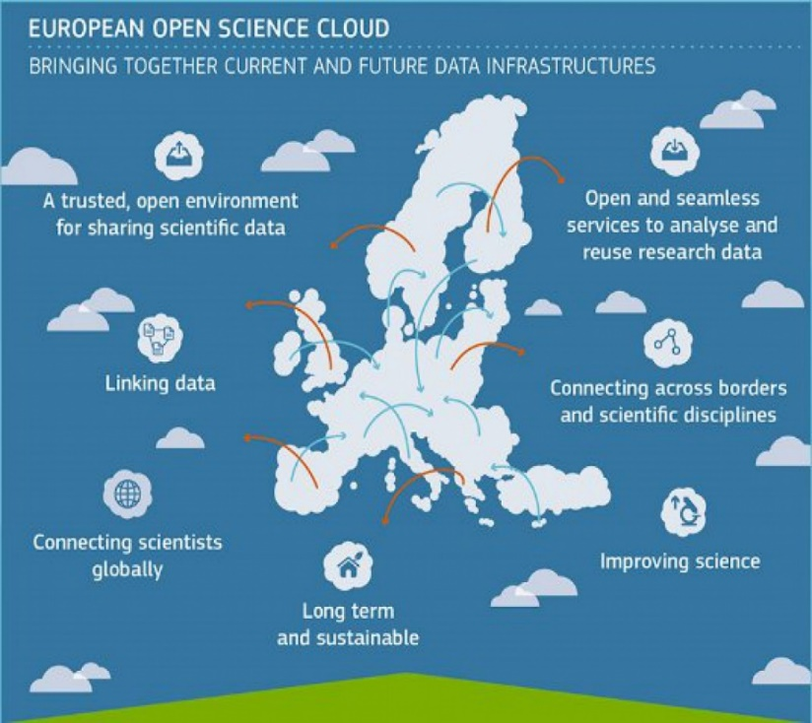
The Vision
EOSC will provide 1.7m EU researchers an environment with free, open services for data storage, management, analysis and re-use across disciplines EOSC will join existing and emerging horizontal and thematic data infrastructures, bridging todays fragmentation and ad-hoc solutions EOSC will add value and leverage past infrastructure investment (10b per year by MS, two decades EU investment)

Slide 5
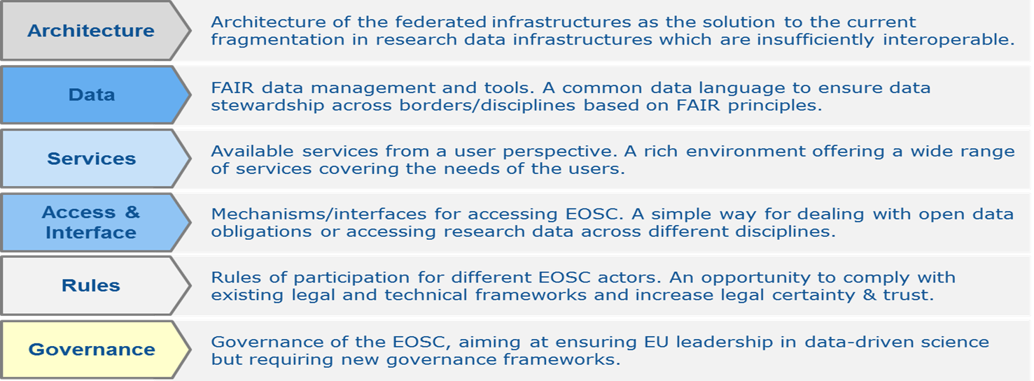
EOSC Model: 6 lines of action
Source: Implementation Roadmap for the European Science Cloud (Staff Working Document SWD(2018) 83), 14 March 2018: http://ec.europa.eu/research/openscience/index.cfm?pg=open-science-cloud

Slide 6
November 2018 – Launch of the EOSC The Vienna Declaration on the European Open Science Cloud https://eosc-launch.eu/declaration/

Slide 7
The Vienna Declaration on the EOSC
The Vienna EOSC Declaration was conceived by Paolo Budroni, University of Vienna and Stefan Hanslik, Austrian Federal Ministry for Education in close cooperation with the European Commission. Vienna, 2018

Slide 8
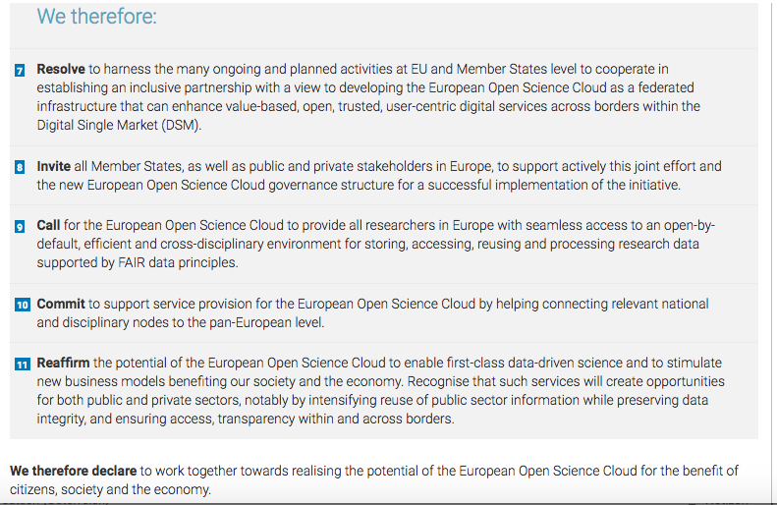
The Vienna Declaration on the EOSC /2

Slide 9
EOSCsecretariat.eu - Supporting EOSC governance
Secretariat support services
1

Slide 10
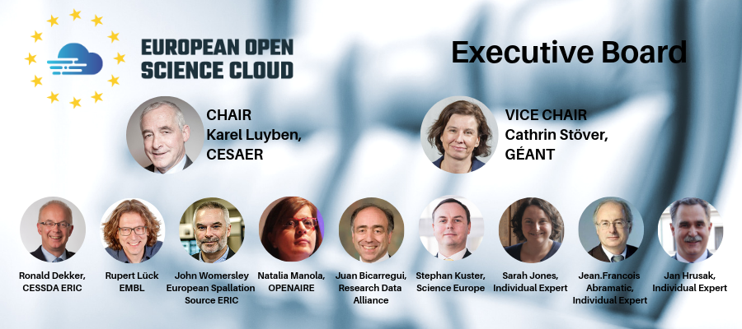
EOSC Executive Board
https://ec.europa.eu/info/news/results-call-applications-selection-members-expert-group-members-executive-board-eosc-2018-nov-23_en

Slide 11
EOSC EB WORKING GROUPS

Slide 12
Setting the scene for 2021+
The EOSC Secretariat, effectively delivers 360° support to the EOSC Governance (Executive Board and Governance Board), works openly and inclusively together with communities to co-create an all-encompassing European Open Science Cloud
Interim character (2019/20), enabling and advisory approach
Working for and under the supervision of the Executive Board and supporting the Governing Board
Supporting a user-centric EOSC implementation, with the Co-creation budget at the command of the EB

Slide 13
EOSC Secretariat: 11 Project partners
TGB
UKRI
ARC
TUWIEN
CERN
KIT
Consortium
CNR- ISTI
Trust-IT
GEANT
GO FAIR
CSC

Slide 14
Relation with EOSC Governance

Slide 15
EOSC Secretariat Project Architecture

Slide 16
EOSC Secretariat: modus operandi
Systematic dialogue via a contact point per addressed stakeholders group (through “Ambassadors” and ongoing online consultations)

Slide 17
Stakeholder Engagement
Researchers & Research Support
Research & Academia Organisations
Policy makers & Funding bodies (incl. EC)
National & EU e-/digital/infrastructures
National & EU funded projects & initiatives
Industry and third sector
17

Slide 18
Engaging with an active Stakeholders community
Coordinate these efforts and initiatives in order to raise awareness and enhance coordination with and among ….
… researchers (AT - TU-Wien)
… infrastructure initiative in the Member States (CNR)
… EU infrastructure initiatives / ESFRI, EInfra, Thematic Clouds, etc) (KIT)
.. international infrastructure initiatives (GO-FAIR)
… industry (CERN)
Support Services for the Stakeholder Forum (CNR)
….. and prepare the transition to new "Stakeholder-based governance”
Notes:
To organize and structure the Stakeholder Forum aiming for an all-inclusive approach. Special attention will be given the approach/engagement with researchers and research communities towards designing a global, researcher-centric EOSC

Slide 19
How can the involved Stakeholders help?
Identifying priority topics
Sharing stakeholder contacts
Putting the players in contact with relevant initiatives & projects
Promoting participation in all initiatives
Requiring responses to collected suggestions by EOSC Governance Board/Executive Board
Fostering the creation of WGs addressing collected suggestions
Participating in the co-creation processes

Slide 20
Co-Creation in EOSC Secretariat…
Setup of co-creation activities and other activities to support EOSC…
Similar to an “Open call” approach, responsible for running the Co-creation process, under which the Co-creation budget will be utilised for participatory, project delivery, and non-foreseen activities
Prepare the transition to new "Stakeholder-based governance”
Notes:
To organize and structure the Stakeholder Forum aiming for an all-inclusive approach. Special attention will be given the approach/engagement with researchers and research communities towards designing a global, researcher-centric EOSC

Slide 21
Participation through stakeholder driven engagement
Why should we get involved?
Defining the EOSC
Vision of research in the next few decades
Real European transversal services, policies, infrastructure, …
What would make our life easier beyond having ubiquitous WLAN access?
How to get involved?
How would you like to get involved?
Dedicated events
Domain-specific conferences
Ambassadors: multipliers and aggregators
Active interaction, through on-line platforms
???
Make sure it will be **OUR** EOSC!!
Notes:
To organize and structure the Stakeholder Forum aiming for an all-inclusive approach. Special attention will be given the approach/engagement with researchers and research communities towards designing a global, researcher-centric EOSC

Slide 22
Name Designation Organisation

